Slide 1




The
Giant’s Ring
www.laganvalleylearning.co.uk

Slide 2
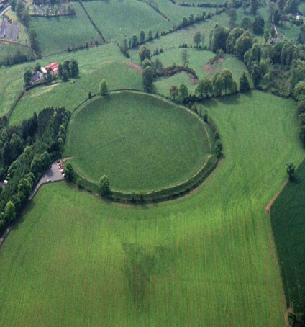

What is the Giant’s Ring?
Circular enclosure 180 meters in diameter.
In the middle of the enclosure stands the remains of a stone tomb.
The surrounding bank is 4 meters high and 18 meters wide.
Due to its size many people believed it was made by a giant!

Slide 3
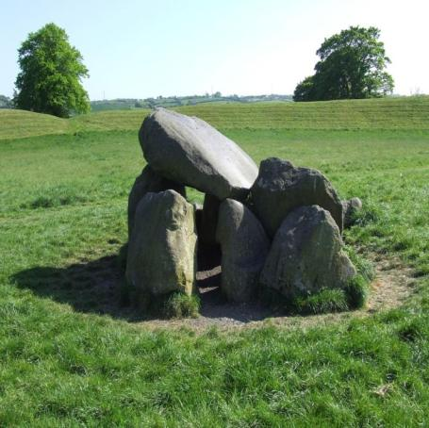
Stone tomb
The stone tomb is likely to be the remains of a passage tomb.
This is where early people would have buried their dead.

Slide 4
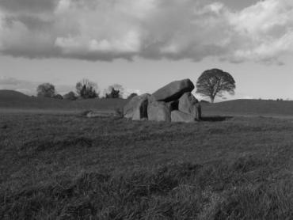
How old is the Giant’s Ring?
Believed to be made around 2000 BC, making it over 4000 years old!
This period of history is known as the Neolithic Period.
The Stone tomb is older with the earth ring or enclosure created later.

Slide 5
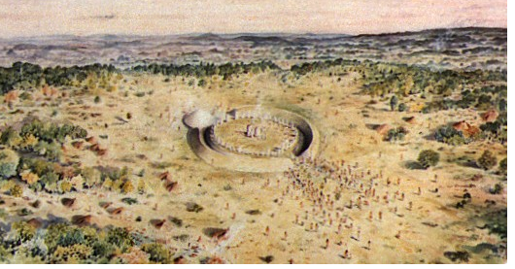
What was it used for?
The Giant’s Ring is known as a henge monument. It was a special place which may have been used for:
  Tribal meetings
  Religious ceremonies
  Commercial gatherings
  Social events

Slide 6
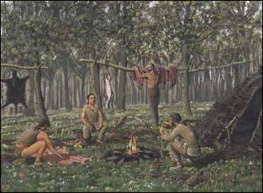
Early life in Ireland
The Giant’s Ring was made
over 4000 years ago during
the Neolithic Period.
The first settlers came to
Ireland approx 7000 years
ago during the Mesolithic
period.
Mesolithic people are
known as hunter gatherers
as they travelled from place to place in search of food.
Mesolithic people used flint, bones and wood to make tools.

Slide 7
Neolithic period
Next came the Neolithic period which saw the first farmers in Ireland.
People settled in one place and fields were made, animals domesticated.
They lived in small family groups.
Neolithic people began to make clay pots, many of which are buried in tombs with the dead.

Slide 8
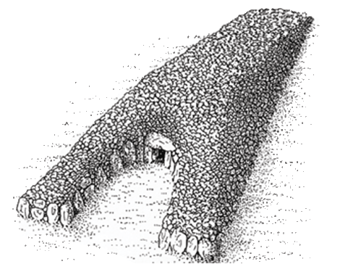
Megalithic tombs
Neolithic people were the first to build tombs for the dead.
Types of tomb :
Court Tomb

Slide 9
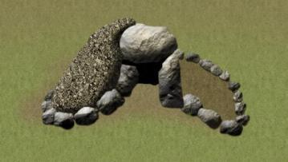
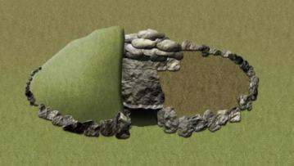
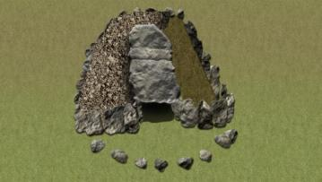
Megalithic tombs
Portal Tomb
Passage Tomb
Wedge Tomb

Slide 10
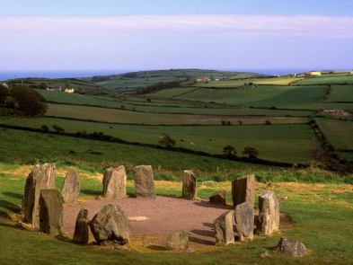
The Bronze Age
After the Neolithic period came the bronze Age between 2500 - 2000 BC.
Bronze is an alloy of copper and tin. It was used to make tools and weapons.
The Bronze Age same the construction of stone circles and standing stones throughout Ireland.

Slide 11
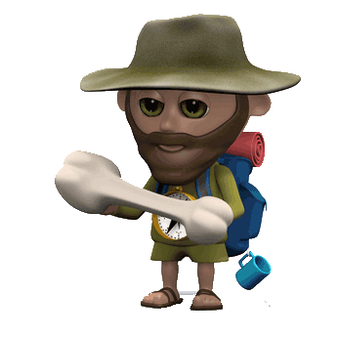
Archaeology
Archaeology is a scientific way of discovering new information about people that lived in the past by finding and studying the things that they left behind.
An archaeologist is a person that is a specialist in archaeology. He or she can be thought of as a kind of detective whose job is to solve the mystery of who our ancestors were.
In the 1800s H. Pitt-Rivers, showed how important it was to make organized lists of the artefacts that he found and record details about the places where he found them.
He believed that the ordinary details and objects were very important in telling the story of who the people were and what they were like.

Slide 12
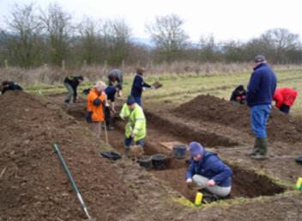
Archaeology
Many sites are dug up or excavated to find objects and the remains of settlements.
This is carefully done using grids and sections with any objects carefully recorded and looked after.
At the Giant’s Ring, excavations took place in 1917, 1929 and 1954, this helps us to tell the story of the monument.

Slide 13
www.laganvalleylearning.co.uk

